Slide 1
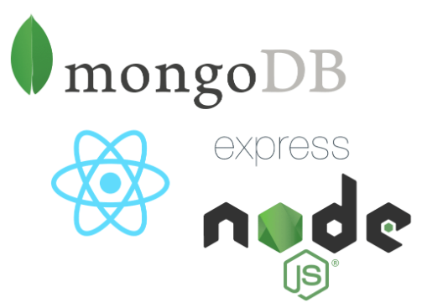
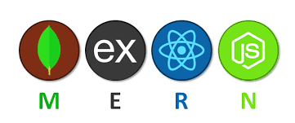
One Day Workshop on
MERN full Stack
Guru Nanak Institute of Mgt & Tech

Slide 2
Agenda
Intro to MERN Full Stack
Installation and Setup
NPM (Node Package Manager)
Creating Basic Node App
Hands on Practice
Hosting the App

Slide 3
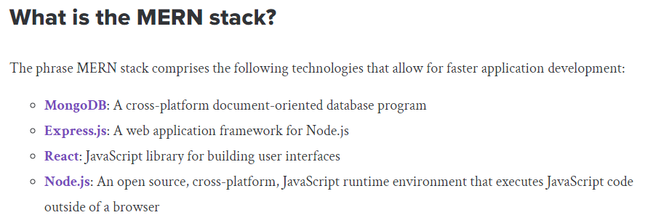

Slide 4
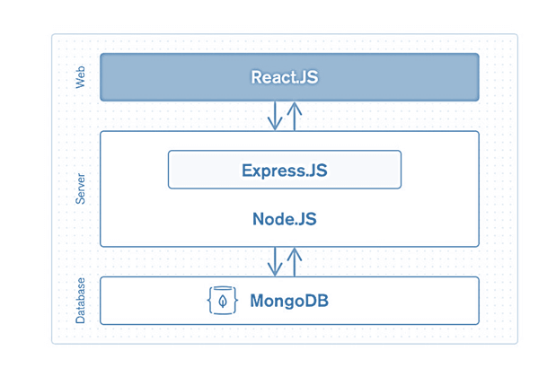
Architecture

Slide 5
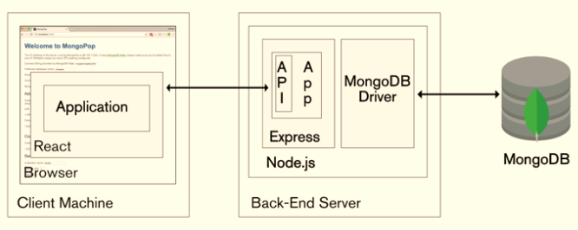
Architecture

Slide 6

Mongo DB is the most popular NoSQL (NoSQL or Non Structured Query Language) database, an open-source document-oriented database.
The term 'NoSQL' typically means a non-relational database that does not require a fixed schema or proper relational tables to store the necessary data in it.
It implies that MongoDB is not based on the table-like relational database structure.
The storage format in which the data is stored is known as BSON, which stands for Binary JavaScript Object Notation
MongoDB uses BSON when storing documents in collections.
It allows a highly scalable and flexible document structure.

Slide 7

Express is a JavaScript server-side framework that runs within js.
It provides the developer with a platform to create and maintain robust servers.
Express is used for building and designing web and mobile applications easily and quickly.
Express organize the application's functionality with routing and middleware.
It also adds helpful functionalities to Node.js HTTP (HyperText Transfer Protocol) objects.

Slide 8

React is an open-source JavaScript library maintained by Facebook that can be used for creating views rendered in HTML.
Unlike AngularJS, React is not a framework. It is a library
It is used to build user interfaces for single page web application.
React is also used for making a grip over the view layer for mobile and web applications.
It allows us to create reusable UI ( User Interface ) components.
React was first deployed in the Facebook news feed.
It allows developers to create large web applications that can easily change the data of the page even without reloading the page.
The main objective of reacting is that it only works on user interfaces in the application, whether mobile or web.

Slide 9
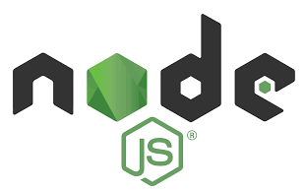
Ns is an open-source server environment, and it is a cross-platform runtime environment for executing JavaScript code outside a browser.
js is not a programming language, and even it is not a framework.
It is often used for building and developing numerous backend services like net applications, mobile applications.
Massive corporations principally utilize it in production like Uber, PayPal, Netflix,
It may be a free ASCII text file platform and may be utilized by anybody.
It will run on numerous operative systems like Windows, Mac, Linux, Unix, etc.
It is incredibly simple to urge started with it and may even be used for agile development and prototyping.
It provides extremely ascendable and really quick services to the users.
It is incredibly consistent and may be used as an ASCII text file cleaner.
It continuously uses JavaScript; thus, it's ultimately helpful for a computer user to quickly create any net service or any net or mobile application.
It provides a massive system for any ASCII text file library.
It contains a Non-blocking or, can say, Asynchronous nature.

Slide 10
npm start and install
npm install
- This command is primarily used to install the dependencies listed in your project's `package.json` file.
- These dependencies are the external libraries and tools your project relies on.
- It creates or updates the `node_modules` directory, where these dependencies are stored.
- It can also update the package-lock.json file.

Slide 11
npm start and install
npm start:
- This command is used to run the start script defined in your `package.json` file.
- It's typically used to start your application's development server or run the main application.
- Executes the command specified in the `scripts.start` field of your `package.json` file.
- The specific action depends entirely on what's defined in that script.
- Often, it initiates a development server (e.g., for React or Angular projects) or runs a Node.js server.

Slide 12
Key Differences Summarized:
`npm install` is about installing dependencies; `npm start` is about running the application.
`npm install` retrieves and places code into the node_modules folder. `npm start` executes a command line script.
JSON (JavaScript Object Notation) is a lightweight, text-based data interchange format

